Slide 1
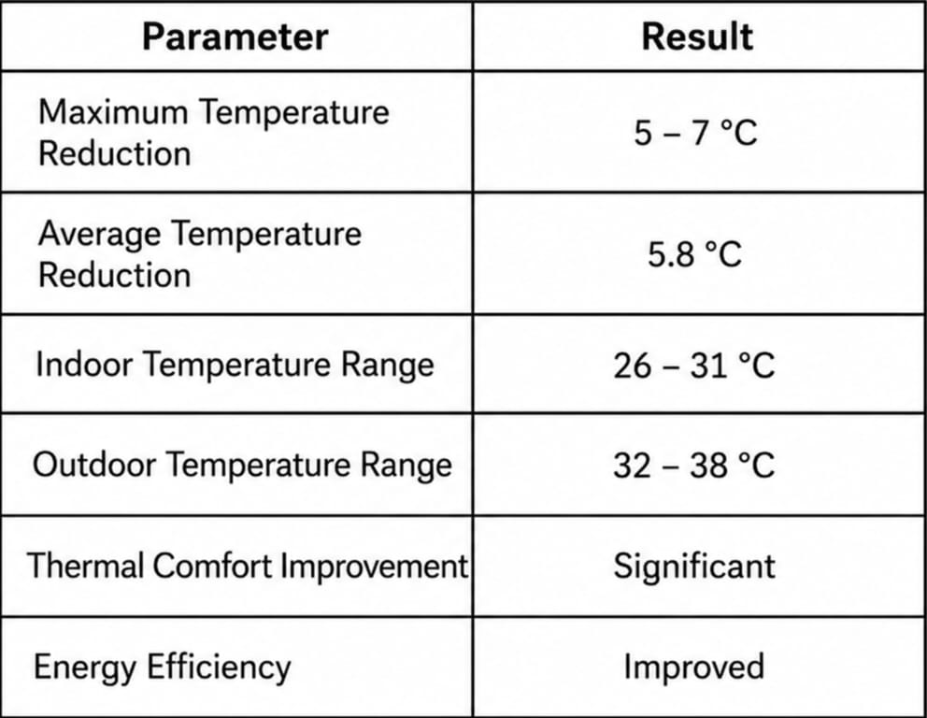
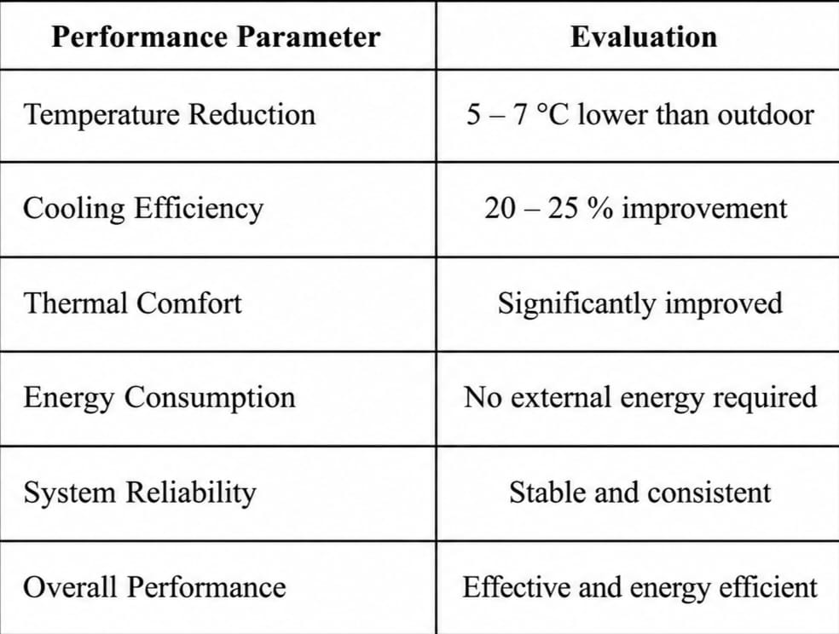
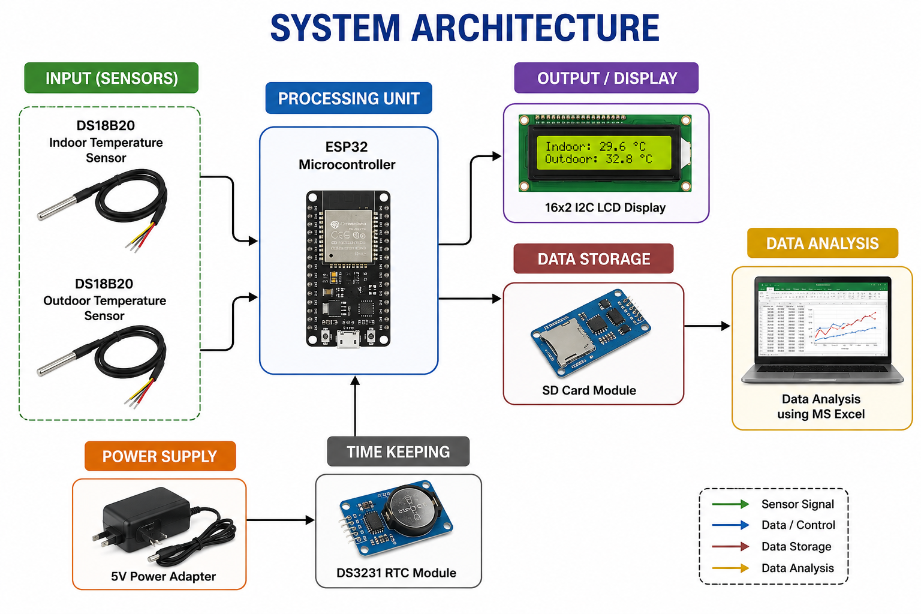
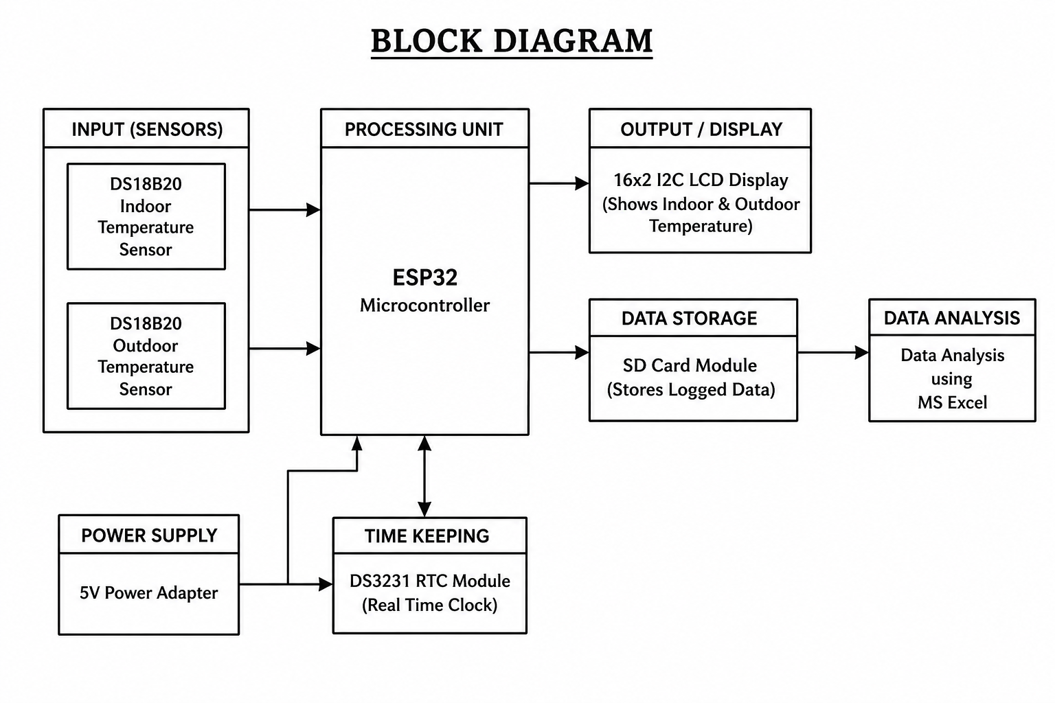

PASSIVE COOLING SYSTEM FOR HOMES
Project Abstract
This project presents a Passive Cooling System for Homes that reduces indoor temperature using natural cooling techniques such as thermal insulation, reflective materials, shading, and natural ventilation. An ESP32-based monitoring system with DS18B20 temperature sensors records indoor and outdoor temperatures for performance analysis. Experimental results show that the system reduces indoor temperature by 5–7°C, improving thermal comfort while reducing energy consumption. The proposed system is a low-cost, eco-friendly, and sustainable solution for residential buildings in tropical regions
Problem Statement
Residential buildings in tropical regions consume significant electrical energy for air conditioning. Conventional cooling systems increase electricity bills and greenhouse gas emissions. There is a need for an affordable, energy-efficient cooling solution that maintains indoor comfort without relying on mechanical cooling systems
Need for the Project
The project is needed to reduce indoor temperature naturally, minimize electricity consumption, improve thermal comfort, and provide a cost-effective, energy-efficient, and environmentally friendly cooling solution for homes in tropical regions.
Project Objectives
To design a low-cost passive cooling system for residential buildings.
To monitor indoor and outdoor temperatures using an ESP32-based system.
To improve thermal comfort while reducing energy consumption.
Expected Learning Outcomes
Achieve a 5–7°C reduction in indoor temperature.
Improve thermal comfort with reduced energy consumption.
System Requirements
Hardware:The hardware consists of an ESP32 microcontroller, two DS18B20 temperature sensors, a DS3231 RTC module, an SD card module, a power supply, and connecting wires for temperature monitoring and data logging.
Software:The software includes Arduino IDE for programming the ESP32, Embedded C for code development, and Microsoft Excel for analyzing the recorded temperature data.
Methodology / Workflow
Literature Survey → System Design → Prototype Development → ESP32 & Sensor Integration → Temperature Monitoring → Data Logging → Performance Analysis → Results & Conclusion
System Architecture
Block Diagram
Project Development Process
Problem Identification → Literature Survey → System Design → Prototype Development → Hardware Integration → Testing→ Result Analysis → Conclusion
Implementation
The passive cooling prototype was developed using thermal insulation, reflective roofing, and natural ventilation techniques. An ESP32-based monitoring system with DS18B20 temperature sensors was integrated to measure and record indoor and outdoor temperatures for performance evaluation..
Algorithms / Models Used
Algorithm / model 1:Passive Cooling Technique (Natural Ventilation & Thermal Insulation)
Algorithm / model 2:ESP32-Based Temperature Monitoring and Data Logging System
Dataset / Input Data (if applicable)
Indoor and outdoor temperature readings collected using DS18B20 temperature sensors at regular time intervals were used as the input data for performance evaluation.
Experimental Setup
A scaled house prototype was constructed using insulating materials, reflective roofing, and natural ventilation. An ESP32 with two DS18B20 temperature sensors was used to measure and record indoor and outdoor temperatures for performance evaluation.
Results
Performance Evaluation
Testing and Validation
The developed prototype was tested under real environmental conditions, and the recorded temperature data validated its cooling performance and reliability.
Challenges Encountered
Challenge 1:Achieving effective insulation with low-cost materials.
Challenge 2:Maintaining accurate temperature monitoring and data logging.
Solutions Implemented
Solution 1:Used reflective insulation and natural ventilation to reduce heat gain.
Solution 2:Integrated an ESP32-based system for real-time temperature monitoring and data logging.
Innovation / Novel Features
Combines passive cooling techniques with an ESP32-based real-time temperature monitoring system for an energy-efficient and low-cost residential cooling solution.
Applications
Residential buildings for energy-efficient cooling.
Low-cost and eco-friendly housing in tropical regions.
Future Scope
The system can be enhanced with IoT-based remote monitoring, AI-driven temperature prediction, and solar- powered operation.
Project Outcomes
Achieved a 5–7°C reduction in indoor temperature, improving thermal comfort and reducing energy consumption..
Skills Acquired
Technical skill 1: ESP32 Programming, Embedded C, Sensor Interfacing, Prototype Development, Temperature Monitoring, Data Analysis.
Soft skill 1: Teamwork, Problem Solving, Communication, Time Management.
References
A. Bahga and V. Madisetti, Internet of Things: A Hands-On Approach. Hyderabad, India: Universities Press, 2015.
Passive Cooling of Buildings B. Givoni, Passive Cooling of Buildings. New York, NY: Wiley, 1994
ESPRESSIF Systems, ESP32 Series Datasheet, Espressif Systems, China, 2023.
Acknowledgements
Department of Mechanical Engineering, Knowledge Institute of Technology, Salem.
Project Guide and Team Members for their valuable guidance and support
[Insert QR Code]
QR Code — Project Report (PDF) | Source Code Repository | Demonstration Video
Contact information
Department of Mechanical engineering, Knowledge Institute of Technology, Salem
Email: 2k23me115@kiot.ac.in | www.kiot.ac.in

